Slide 1
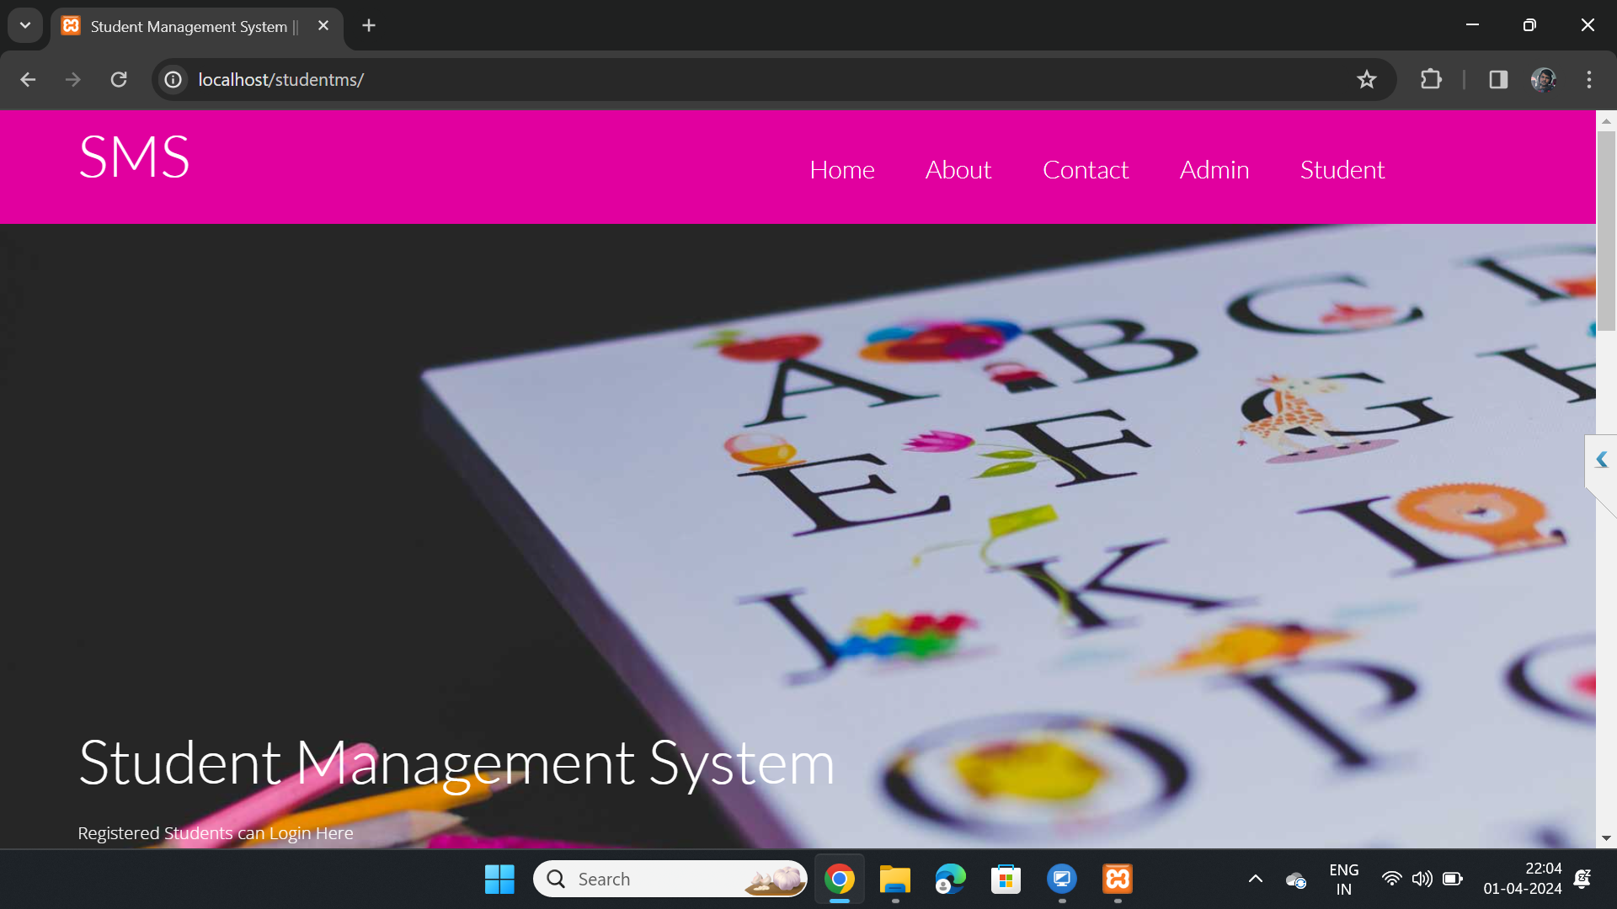

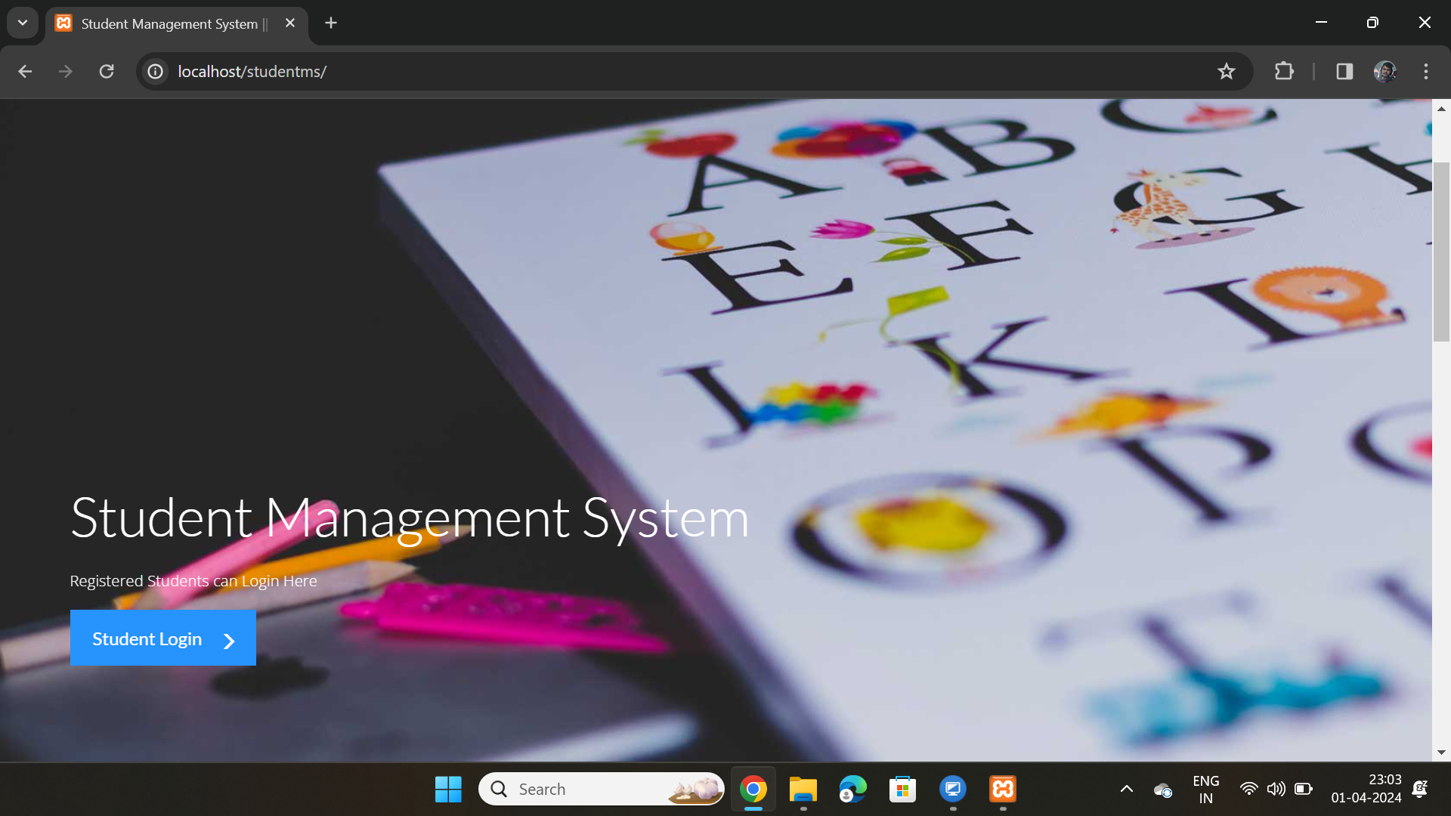
ARJIT KUMAR MOHAPATRA
RAJEEB LOCHAN JENA

Slide 2
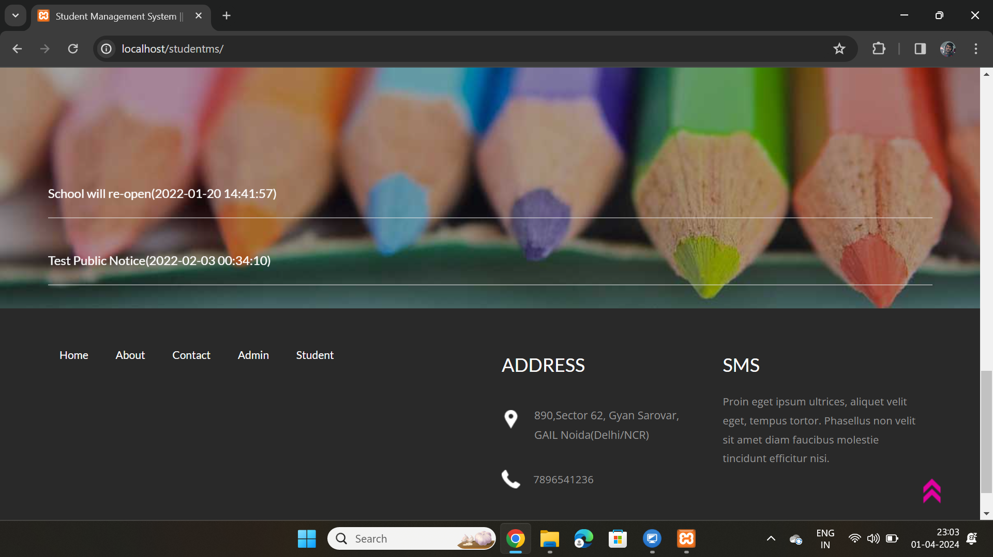
FOOTER OF SMS

Slide 3
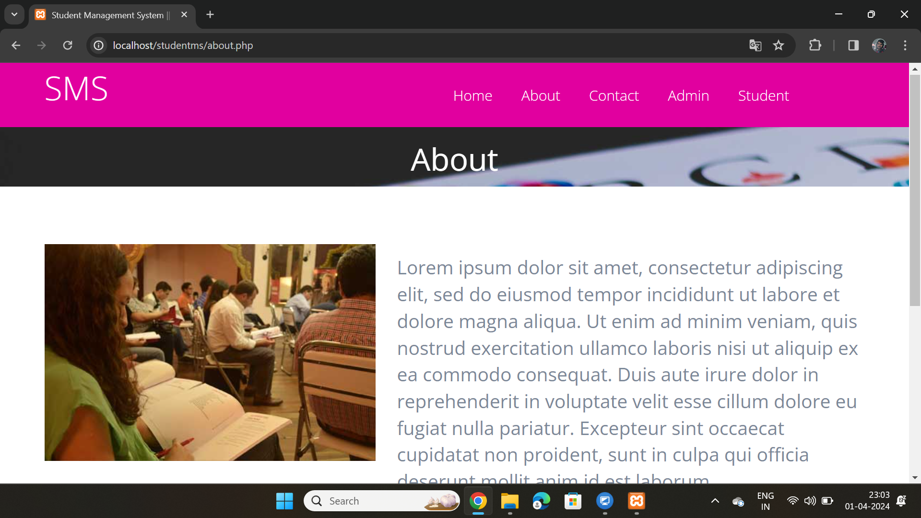

Slide 4
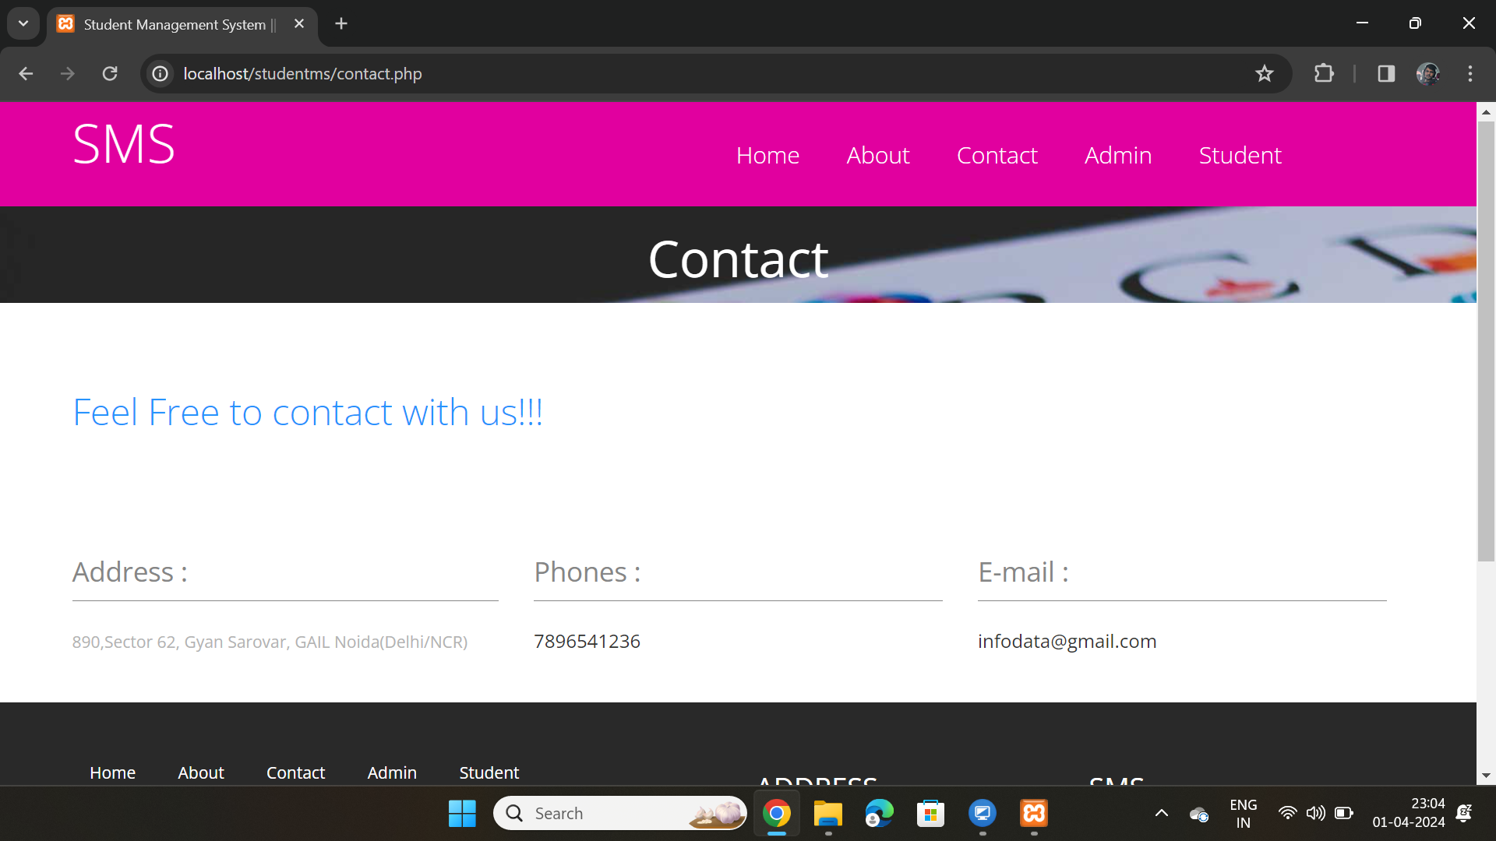
Biometric Modalities
ff

Slide 5
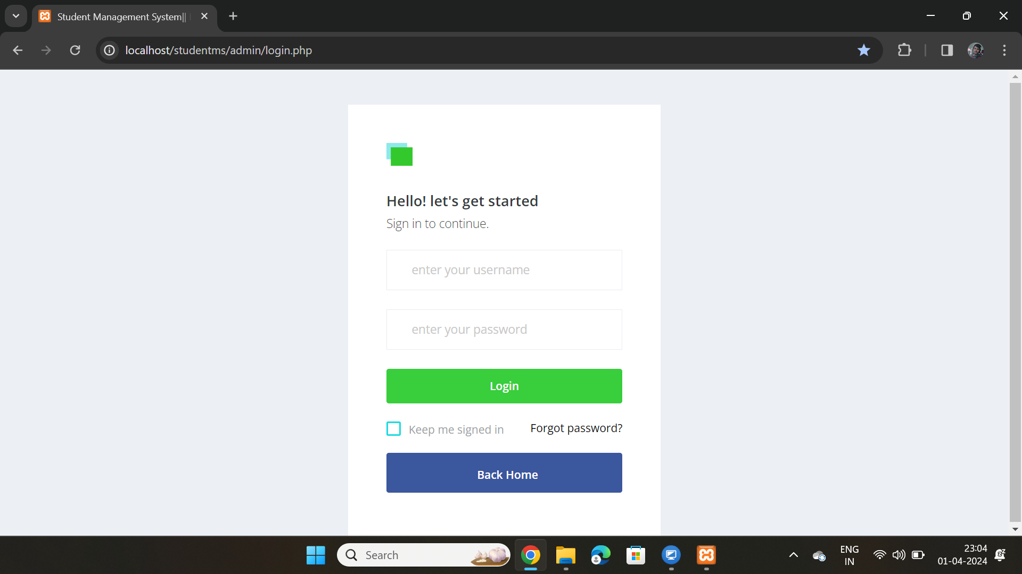
ADMIN LOGIN PAGE FOR THE ADMINS

Slide 6
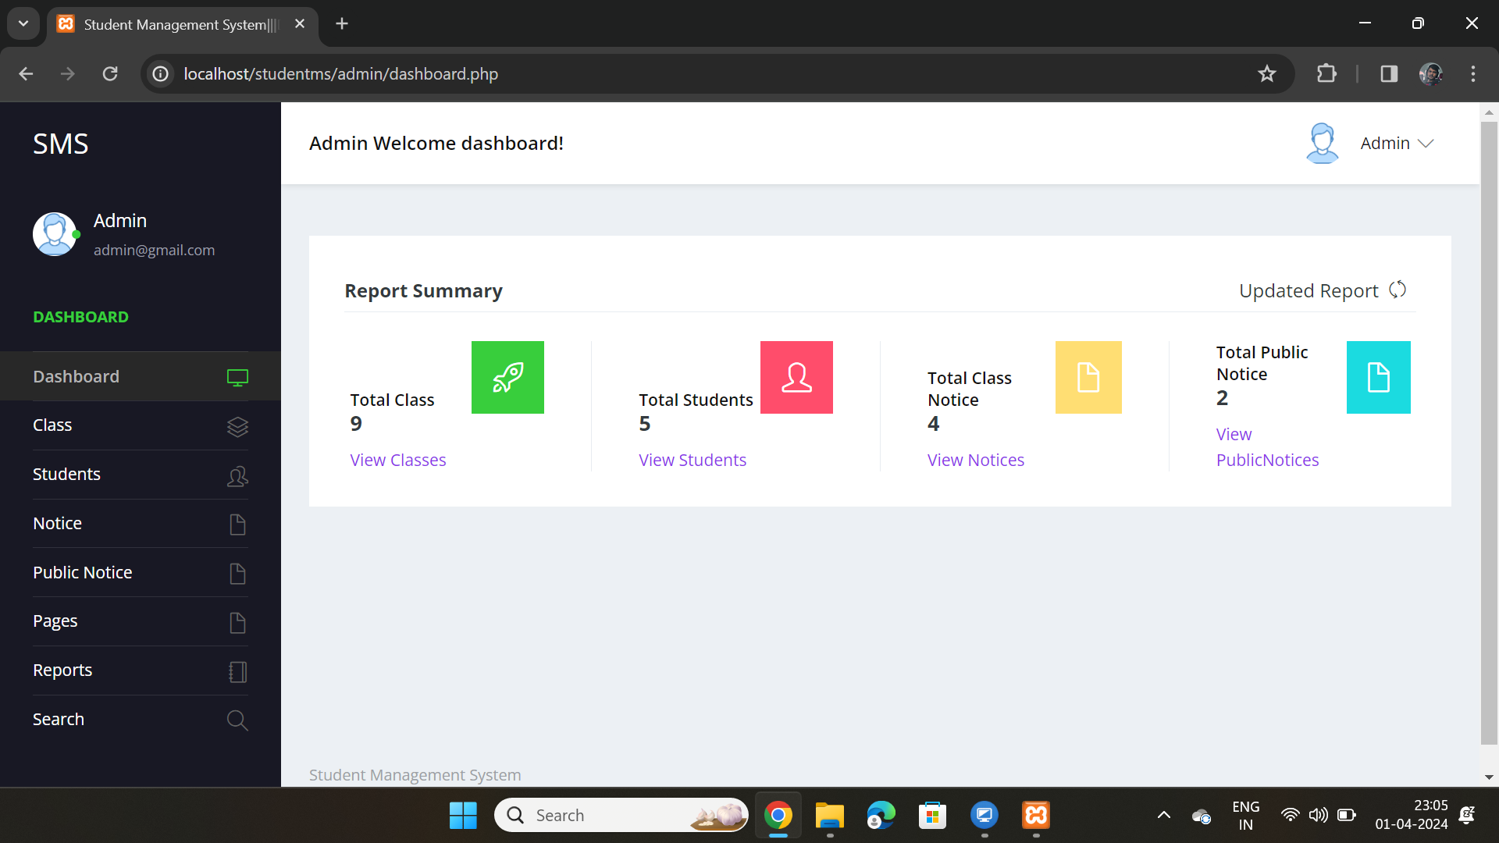
Advantages

Slide 7
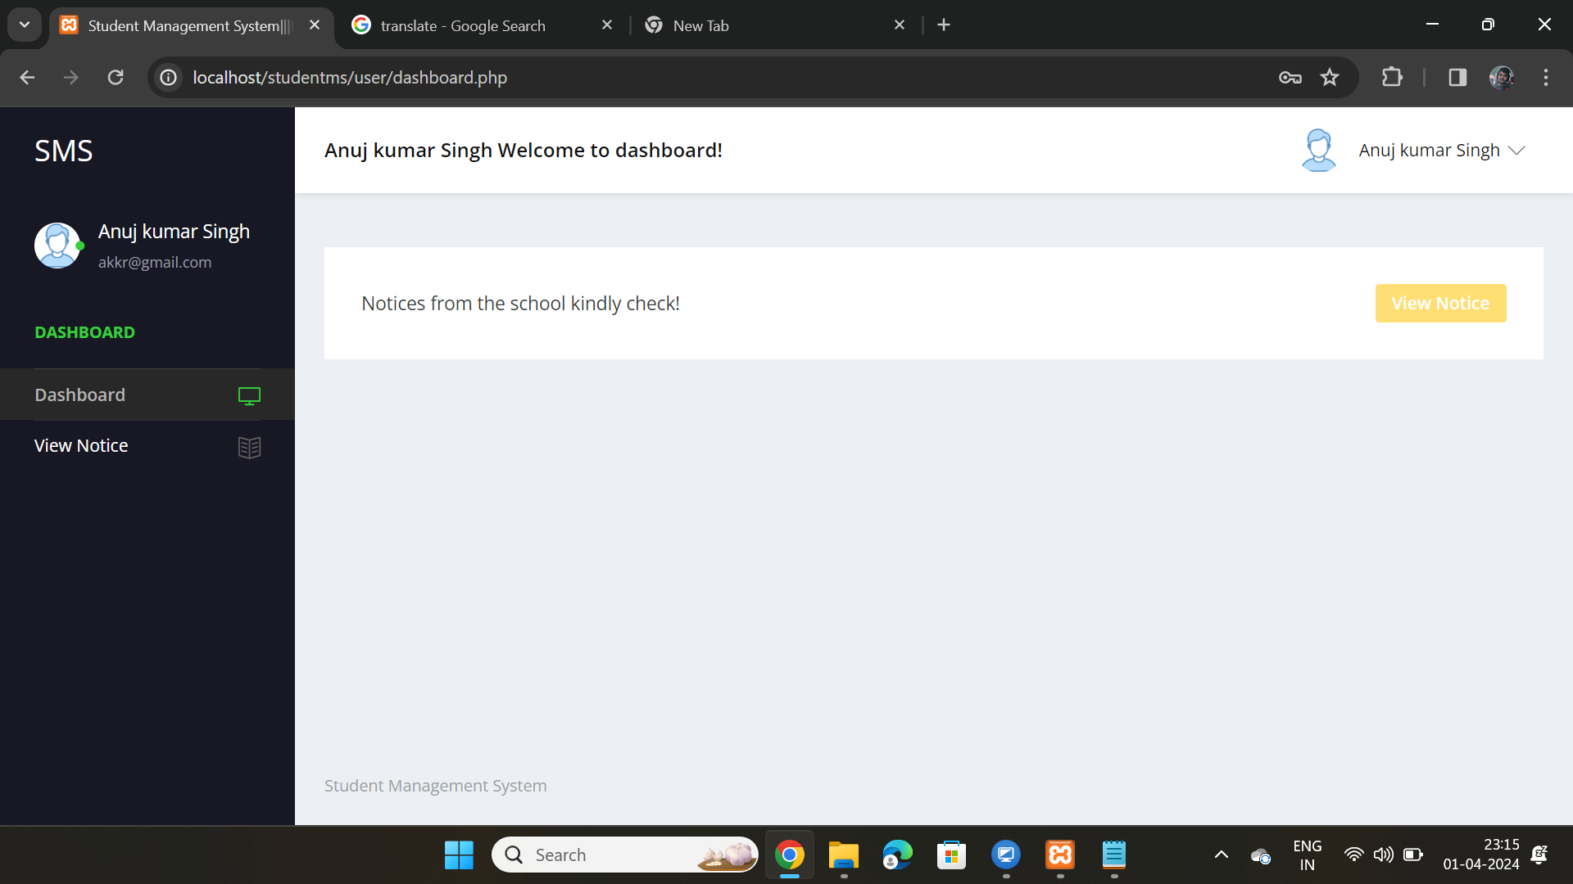
STUDENT LOGIN PAGE FOR STUDENTS WHO REGISTERED FOR CLASSES .
HERE STUDENT CAN SEE THE NOTICES PROVIDED BY ADMIN .
STUDENTS NEED THEIR STUDENT ID AND PASSWARD IN ORDER TO LOGIN TO THE PORTAL.

Slide 8
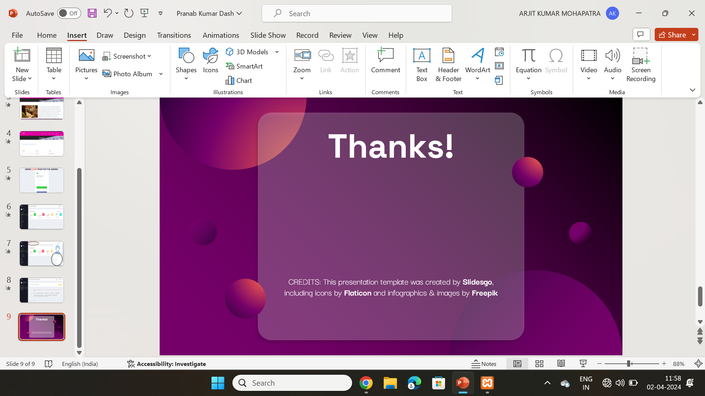
Thanks!

